Slide 1
PAUSELAB
BECVILLE PARTICIPATORY BUDGETING SYSTEM
Sudipta Quabili, Oscar Sandoval, Amir Gurung, Sugat Poudel, Henry Garrett, Jay Sebastian

Slide 2
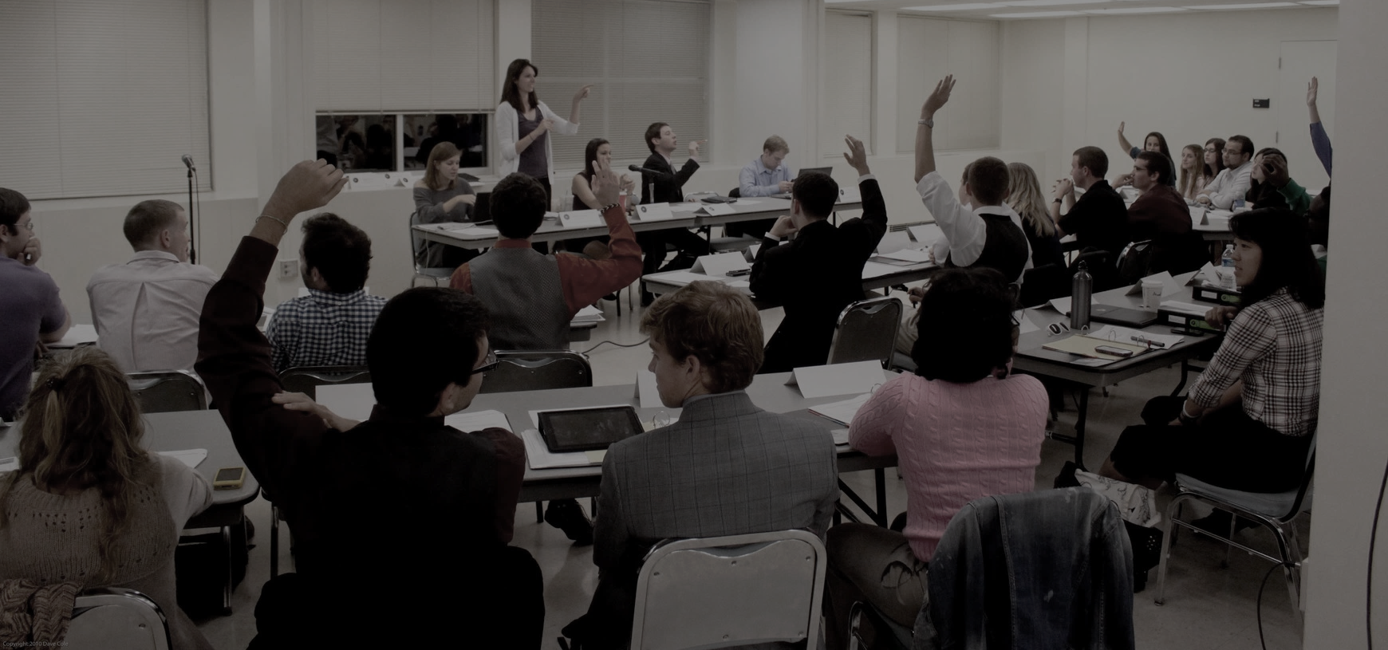


INTRODUCTION
Participatory budgeting system that will lead to community engagement and betterment.
The system will facilitate all of the steps of the project cycle, from gathering ideas to keeping residents updated.

Slide 3
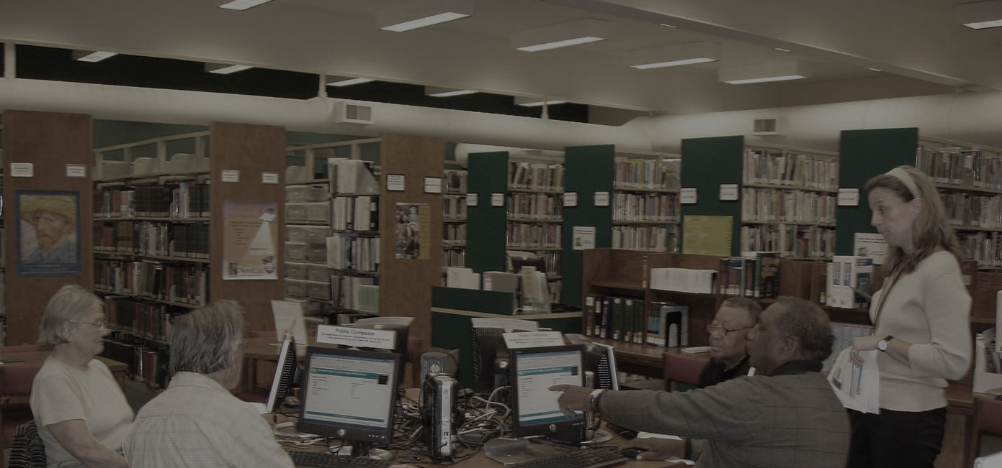

USERS
RESIDENT
Residents are responsible for driving participatory budgeting. They submit ideas, like and view ideas, and vote on proposals.
ARTIST AND SUPER-ARTIST
They submit proposals and super-artists keep resident updated on proposals.
STEERING COMMITTEE MEMBER
They view all ideas/proposals, privately comment on ideas/proposals.
MODERATOR
They keep the site in check.
ADMIN
They can manage the entire system and can change user information.

Slide 4
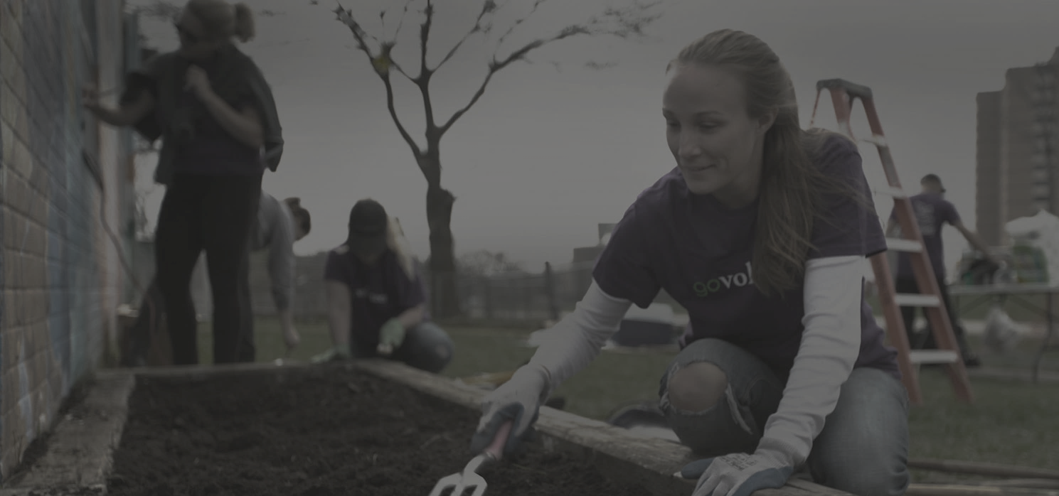

FUNCTIONALITY
IDEAS PHASE
Residents see a map of ideas upon entering the site.
Residents can submit their own ideas with prose and location attached.
Moderators can approve the ideas → they show up on the map!
PROPOSALS PHASE
Artists see a card list of all ideas, and can see which ones have support (likes).
Artists submit proposals, which are approved by moderators.
Steering committee can make internal comments on proposals.
VOTING PHASE
Residents can submit a voting form for three proposals they support.
The proposals with the highest votes will be funded.
Throughout all phases, a “News” tab keeps community up to date on what’s going on.

Slide 5












TOOLS USED
THE BASICS
Rails
MySQL
Bootstrap
jQuery
BACKEND SUPPORT
Devise
CanCan
Simple Form
Paperclip
USER-FACING LIBRARIES
Trumbowyg
Recaptcha
Disqus
Google Maps
TESTING STACK
RSpec
SimpleCov
Factory Girl
Faker
Capybara
Teaspoon

Slide 6


PROBLEMS FACED
TECHNICAL ISSUES
Learning curve to Ruby on Rails, CoffeeScript, etc.
Limitations of some libraries.
Getting different parts of testing stack to work with other gems.
Difficult to debug Travis CI specific issues.
Notes:
Technical Issues
Learning curve to Ruby on Rails, CoffeeScript, etc. Ramp up time at beginning of semester.
Limitations of some libraries. E.g. CanCanCan cannot do authorization on a per-field basis, when some fields (e.g. email and name in Idea) should be restricted to some roles (e.g. resident) -- we have to work around this.
Getting different parts of testing stack to work with other gems. E.g. we could not figure out how to test user registrations with Devise.
Unable to “preview” how a build works on Travis CI -- JS testing had problems unique to server.
Design Issues
Presenting ideas in a clean, shareable format. We used Google Maps and had pins for each idea, with an icon representing which category the idea fits. Clicking on an idea opens a popup from which a user can share on Facebook or Twitter.
Structuring the application with distinct phases like idea collection, proposal collection, and voting. We had a pseudo-singleton model (Iteration) with phase information, and changed the site’s homepage and navbar links according to phase.
Having voting interfaces be accessible and yet preventing fraud. We used reCAPTCHA to avoid automation attacks, and an “honor pledge” checkbox to make people aware of their actions -- both steps are unobtrusive.

Slide 7

PROBLEMS FACED
DESIGN ISSUES
Presenting ideas in a clean, shareable format.
Structuring the application with distinct phases like idea collection, proposal collection, and voting.
Having voting interfaces be accessible and yet preventing fraud.
Notes:
Technical Issues
Learning curve to Ruby on Rails, CoffeeScript, etc. Ramp up time at beginning of semester.
Limitations of some libraries. E.g. CanCanCan cannot do authorization on a per-field basis, when some fields (e.g. email and name in Idea) should be restricted to some roles (e.g. resident) -- we have to work around this.
Getting different parts of testing stack to work with other gems. E.g. we could not figure out how to test user registrations with Devise.
Unable to “preview” how a build works on Travis CI -- JS testing had problems unique to server.
Design Issues
Presenting ideas in a clean, shareable format. We used Google Maps and had pins for each idea, with an icon representing which category the idea fits. Clicking on an idea opens a popup from which a user can share on Facebook or Twitter.
Structuring the application with distinct phases like idea collection, proposal collection, and voting. We had a pseudo-singleton model (Iteration) with phase information, and changed the site’s homepage and navbar links according to phase.
Having voting interfaces be accessible and yet preventing fraud. We used reCAPTCHA to avoid automation attacks, and an “honor pledge” checkbox to make people aware of their actions -- both steps are unobtrusive.

Slide 8
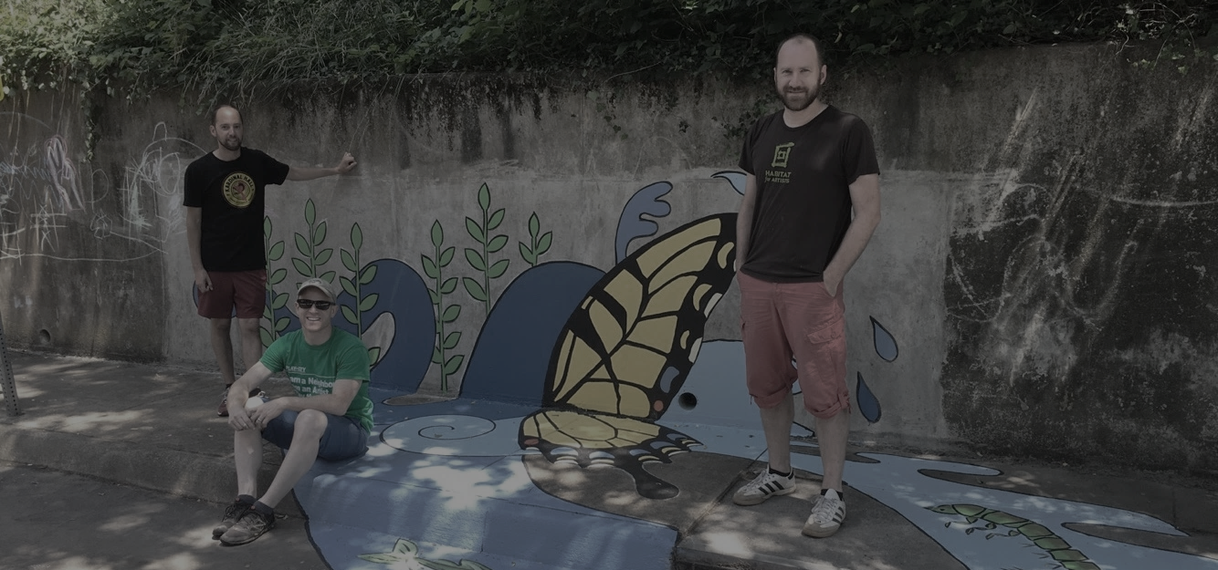


CONCLUSION
We will streamline Pauselab’s idea collection process. This will help the non-profit consolidate all of their processes into one digital platform.
This will improve analytics. Additionally, this will encourage community involvement and make the process of funding community projects more democratic.

